Slide 1
THE ALPHA & OMEGA OF FINANCIAL ANALYSIS:
MONEY-PRINTING LIKE NEVER BEFORE

Slide 2
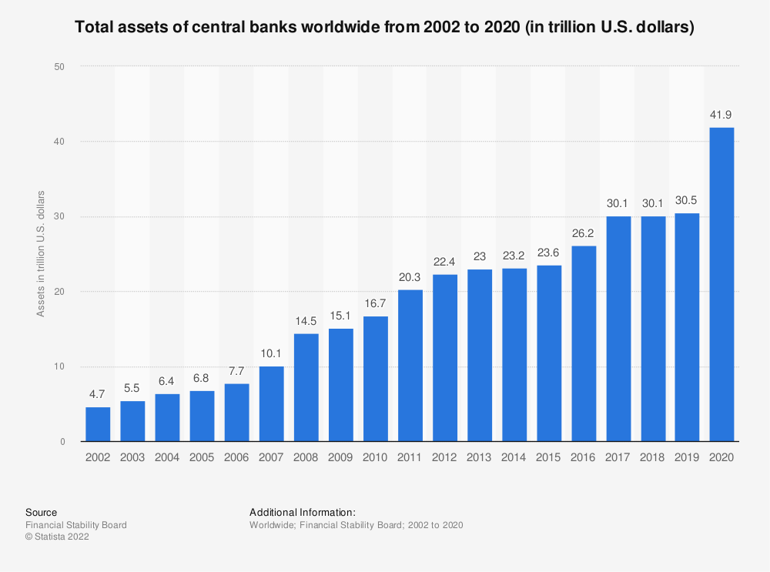
THE ALPHA & OMEGA OF FINANCIAL ANALYSIS:
MONEY-PRINTING LIKE NEVER BEFORE
Between the post-dotcom money-printing break-out and the biblical flood of central bank credit in 2020, global CB balance sheets soared from $4.7 trillion to nearly $42 trillion:
That’s 9X or nearly 13% per annum, and it's downright crazy.
Meanwhile, global GDP barely doubled, rising from $34.6 trillion to $84.7 trillion or just 5.1% per annum.
Before 1986, central bank balance sheets averaged about 5% of GDP and rose to 13% by 2002
Today the ratio stands at 50% on a global basis;

Slide 3
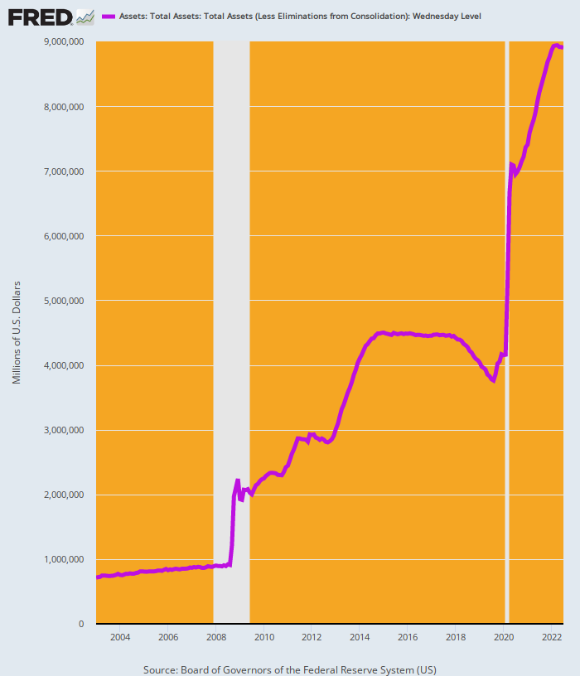
THIS IS NUTS, TOO: GROWTH OF FED BALANCE SHEET SINCE 2008 =18% PER ANNUM
Fed’s Balance Sheet As A Percent Of GDP:
1986: 5.9%;
2009: 15.3%;
2014: 25.3%;
2021: 36.6%

Slide 4
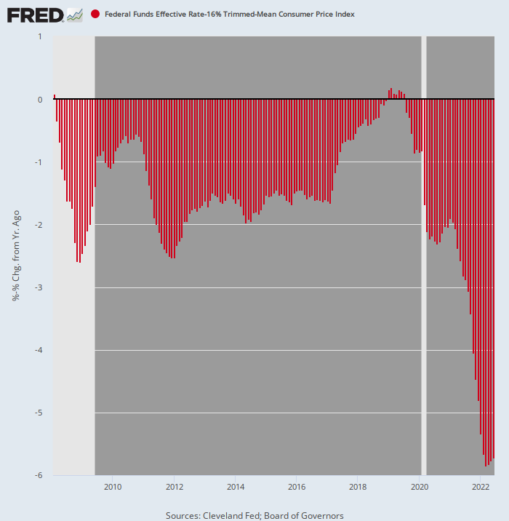
INDEED, IF MONETARY AUTHORITIES COULD BE INDICTED FOR HEINOUS FINANCIAL CRIMES, THIS WOULD BE THE SMOKING GUN
Inflation-Adjusted Fed Funds Rate, Feb.2008-June 2022
During the 172 months since February 2008, the inflation-adjusted Fed funds rate has been positive during only 7 months or just 4% of the time.
Even during those slightly positive months shown peeking above the zero line, the average real funds rate was just 0.13%.

Slide 5
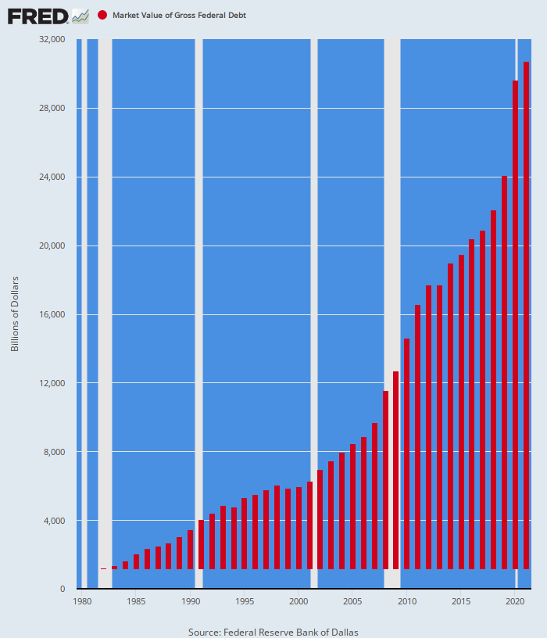
RAMPANT MONETIZATION OPENED THE FLOODGATES TO SOARING PUBLIC DEBT
Public debt grew from $900 billion to $32 trillion in four decades.
That's nearly 10% per annum and double the growth rate of nominal GDP.

Slide 6
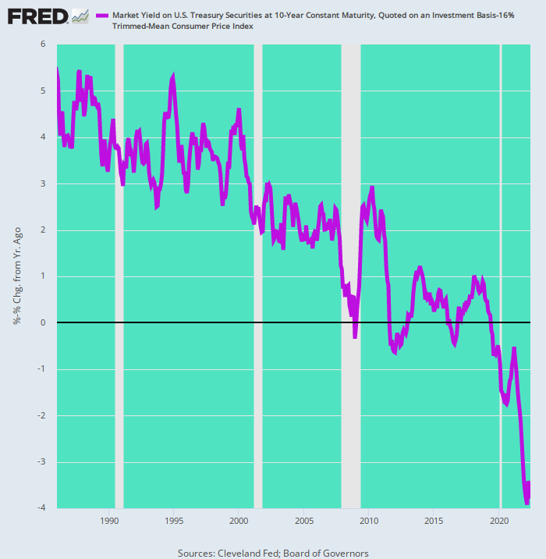
PUBLIC & PRIVATE BORROWERS ALIKE HAD A FEEDING FRENZY ON EVER CHEAPER DEBT IN REAL TERMS
Inflation-Adjusted Yield n The 10-Year UST, 1986-2022
The 16% trimmed mean CPI as a deflator is up by just 6.9% Y/Y versus 9.1% for the headline CPI;
Still, the real 10-year UST yield remained at -3.8% in June and stands at rock bottom compared to the past 36 years.

Slide 7
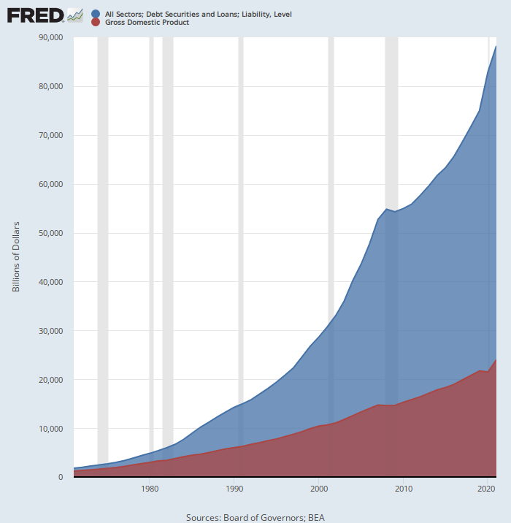
SYSTEMATIC FALSIFICATION OF DEBT PRICES COMPLETED THE BURIAL OF THE US ECONOMY IN PUBLIC AND PRIVATE DEBT
Total US Debt Versus GDP, 1971-2021
When Nixon nixed sound money, the public & private debt to GDP was 1.52X--history's norm.
Thereafter US debt outstanding soared from $1.8 trillion to $88.2 trillion, a gain of 49X.
GDP rose from $1.2 trillion to $24.0 trillion, representing a gain of just 20X.
So the aggregate debt ratio today stands at 3.67X.
That's 2.1 additional turns or $52 trillion of extra debt perched upon the national income.

Slide 8
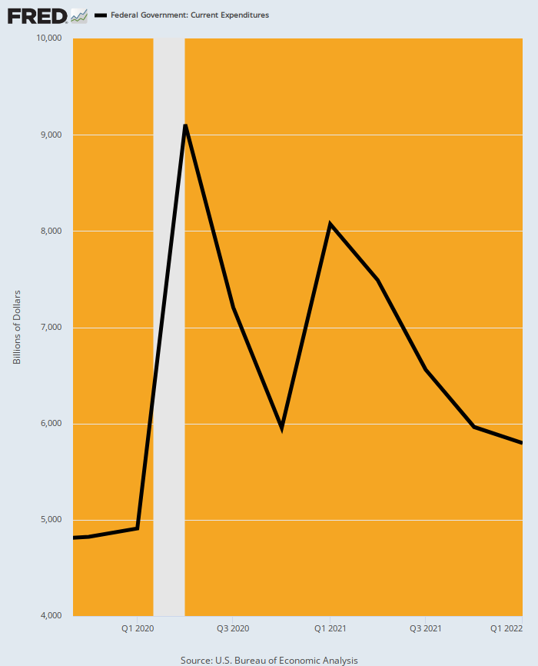
WASHINGTON WAS PRIMED FOR A SPEND-A-THON WHEN THE COVID LOCKDOWNS HIT---SO THE ANNUALIZED FEDERAL SPENDING RATE DOUBLED IN Q2 2020
Q4 2019: $4.8 trillion.
Q2 2020: $9.1 trillion
(stimmy peak # 1).
Q1 2021: $8.1 trillion
(stimmy peak #2).

Slide 9
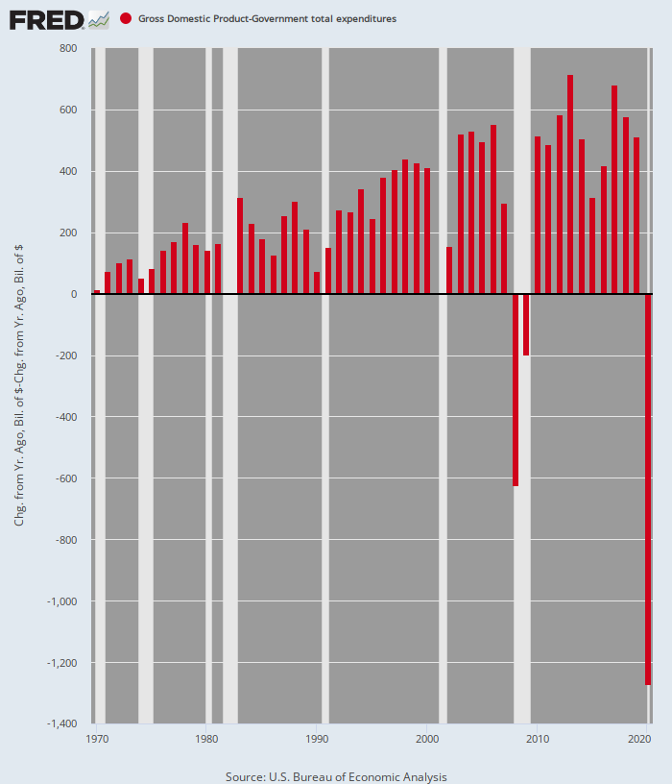
THE VIRUS PATROL PAVED THE WAY FOR THESE COVID SPEND-A-THONS---THE LOCKED-DOWN PRIVATE SECTOR GDP CRASH WAS UNPRECEDENTED
US Nominal GDP Less Total Govt. Expenditures
Nominal GDP Plunged At a $1.3 trillion rate in Q2 2020

Slide 10
ACTUALLY, THE PRIVATE SECTOR COLLAPSE WAS UNNECESSARY B/C THE LOCKDOWNS WERE WRONG
Population/ WITH-Covid deaths/ rate per 100,000 by Age Cohort Thru March 2021
0-17 Years: 73.2 million persons/ 238 deaths/ 0.33 per 100k;
18-29 years: 53.6 million persons/ 1,916 deaths/ 3.6 per 100k;
30-49 years: 84.5 million persons/ 20,717 deaths/ 24.5 per 100k;
50-64 years: 62.9 million persons/78,883 deaths/ 125.4 per 100k;
65-74 years: 31.5 million persons/ 115,381 deaths/ 366.4 per 100k;
75-84 years: 16.0 million persons/ 146,310 deaths/ 916.2 per 100k;
85+ years: 6.6 million persons/ 162,583 deaths/ 2,460.0 per 100k;
All ages: 328.2 million persons/ 526,028 deaths/ 160.3 per 100k.
Mortality rate for elderly was 7,450 higher than for kids under 18 years.

Slide 11
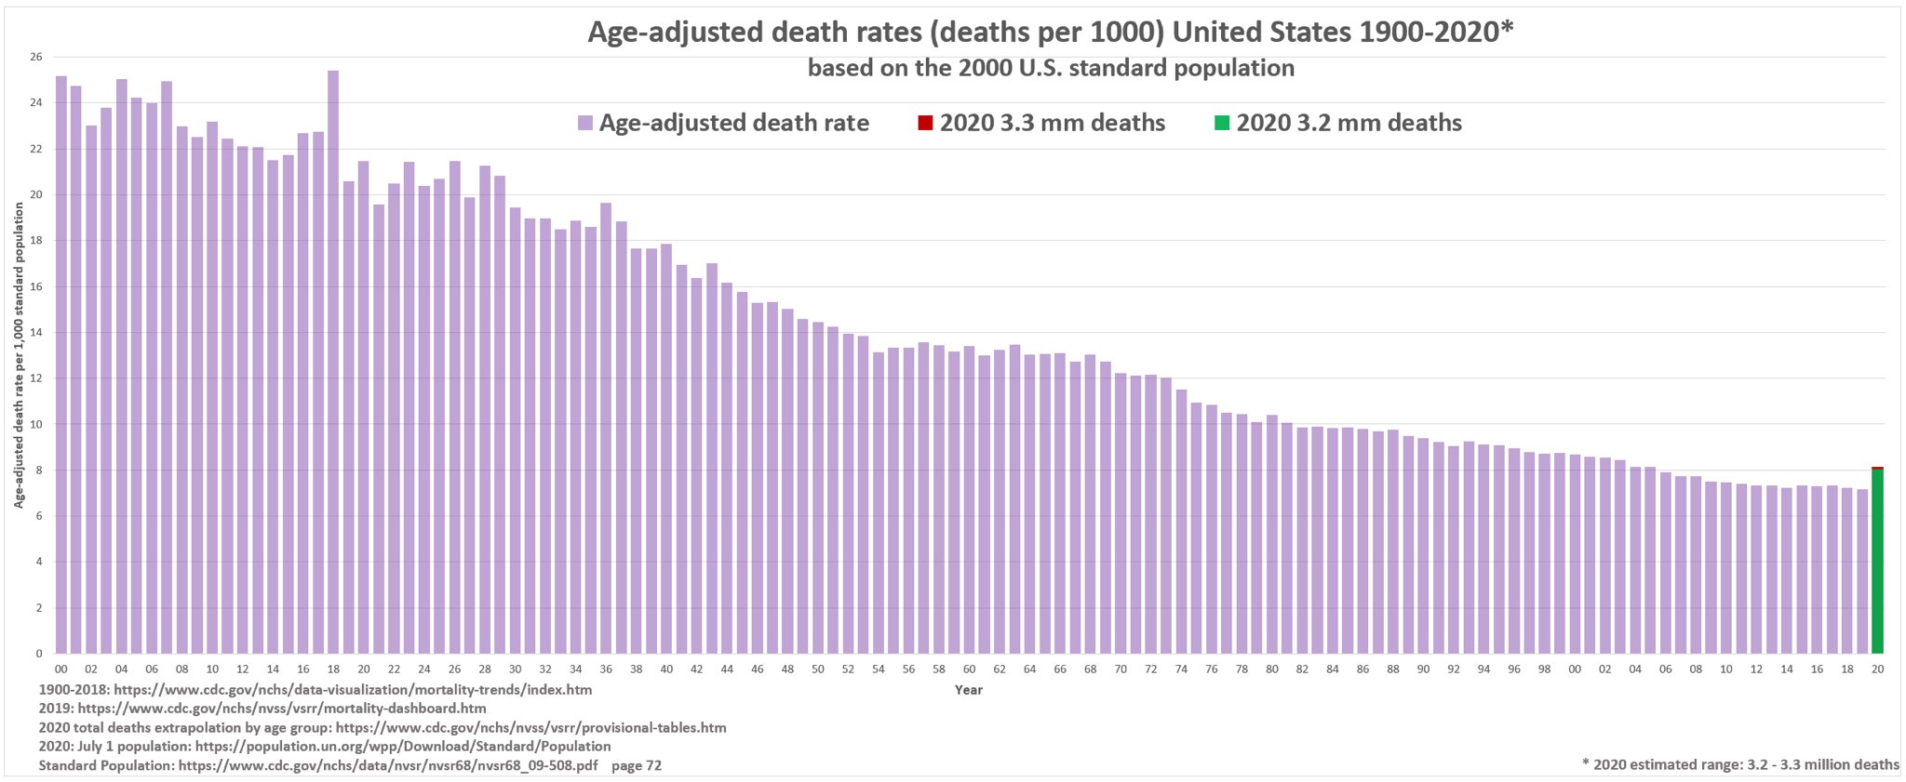
LOCKDOWNS WERE THE GREATEST POLICY MISTAKE IN MODERN HISTORY
81% of all WITH-Covid deaths have been among the 16% of the population (54.1 million) 65 years and older;
Just 4.4% of the deaths tallied by the CDC were among the 64.4% of the population under 50 years (211.4 million).
The overall impact on the US age-adjusted mortality rate was a blip in the 100-year improvement trend, not the Black Plague it was represented to be.

Slide 12
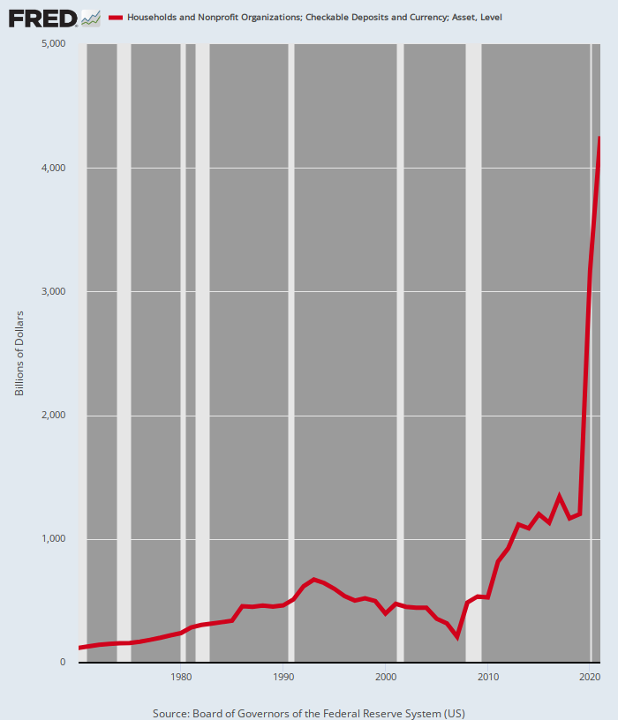
DON'T CALL IT SAVINGS!
Checkable Deposits And Currency Of Households:
Pre-Covid Level @ $500 billion.
Current level @ $4.2 trillion.
Mostly borrowed by Uncle Sam to fund $6 trillion of stimmy handouts

Slide 13
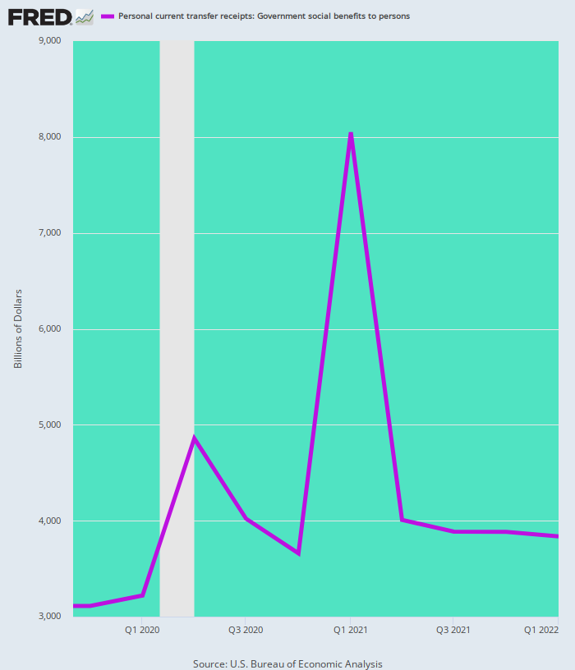
SO BEST CALL IT STIMMIES AND FREE STUFF FOR ALL!
The preponderant share of the bulge in household cash balances was fresh off the Fed’s printing presses one step removed.
Annualized Rate Of Govt. Transfer Payments:
Q4 2019: $3.1 trillion:
Q2 2020: $4.9 trillion
(stimmy peak # 1);
Q1 2021: $8.1 trillion
(stimmy peak # 2);
Q2 2022: $4.0 trillion;
Transfers still up by 29%

Slide 14
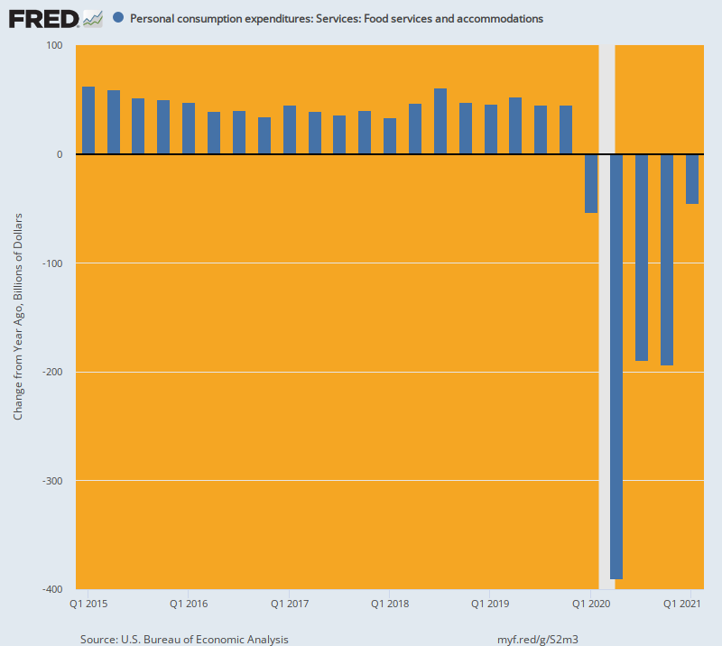
UNSPENDING ON LEISURE & HOSPITALITY WAS UNPRECEDENTED AND MASSIVE
Y/Y Change In Billions:
Pre-Covid Trend: @+$45 billion;
Q2 2020: -$390 billion;
Q3/Q4 2020: -$190 billion
Q2 2020: % Change From Pre-Covid Baseline = -40%

Slide 15
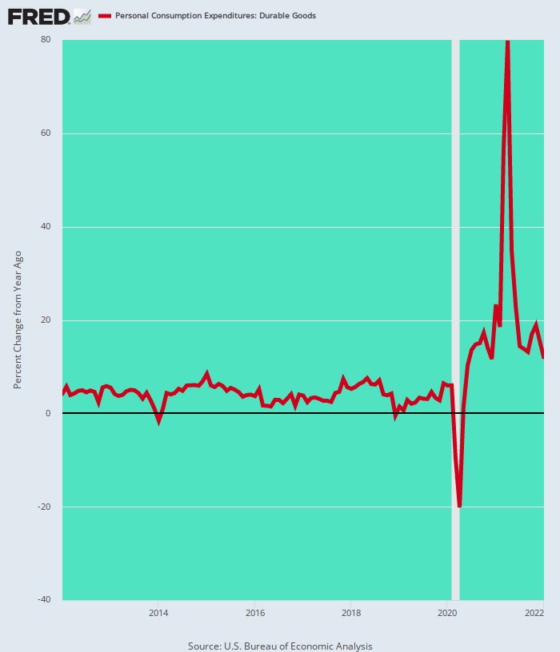
HOME-BOUND & STIMMIED-UP HOUSEHOLDS BOUGHT AMAZON-DELIVERED DURABLE GOODS LIKE THERE WAS NO TOMORROW
PCE Durables: April 2020 Change From Prior Year= +80%

Slide 16
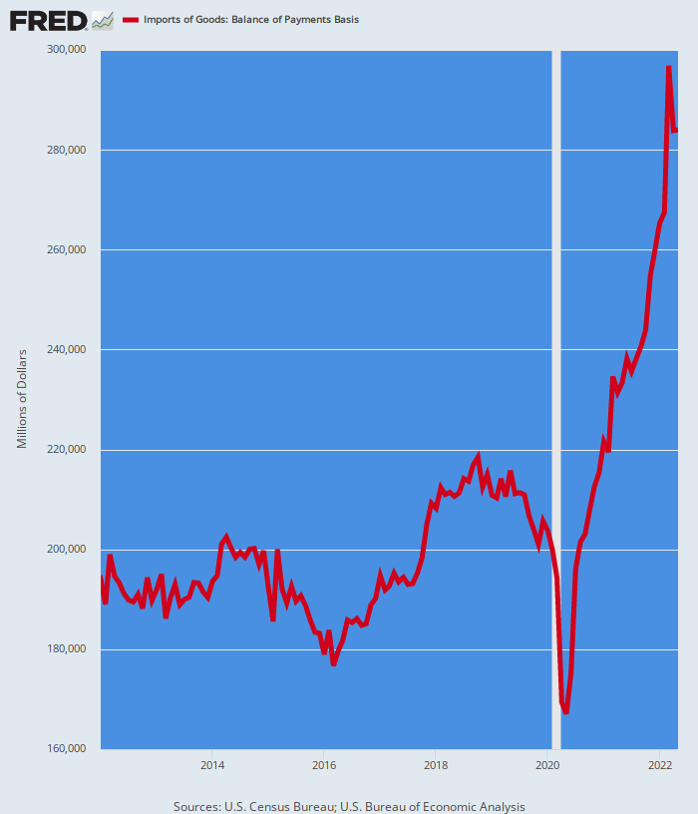
GOOD JOB, WASHINGTON! YOU “STIMULATED” CHINA/GLOBAL SUPPLY CHAIN, NOT DOMESTIC OUTPUT
US Imports Of Goods: March 2022 versus Dec. 2019=+45%

Slide 17
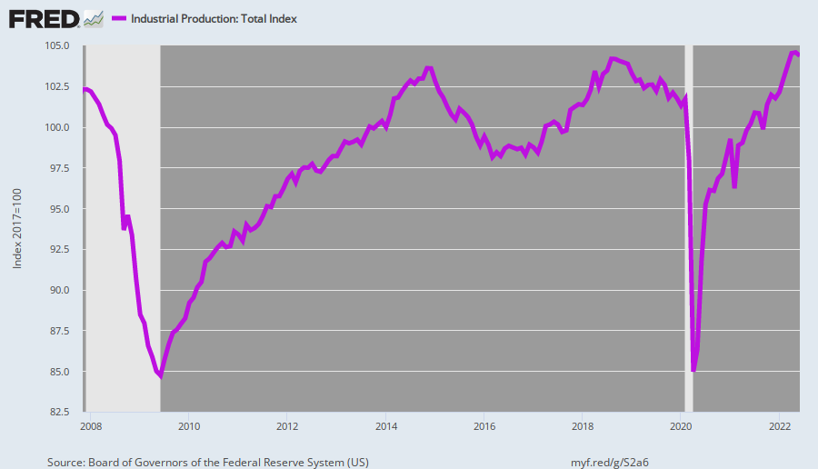
IN FACT, THE GREAT MONETARY & FISCAL STIMULUS ERA HAS NOT STIMULATED MAIN STREET OUTPUT
Industrial Production Index:
November 2007 pre-crisis peak: 102.3;
November 2019 pre-Covid peak: 102.0;
$11 trillion of Fiscal & Monetary Stimmies later (June 2022): 104.3;
2007-2022 CAGR: 0.14%

Slide 18
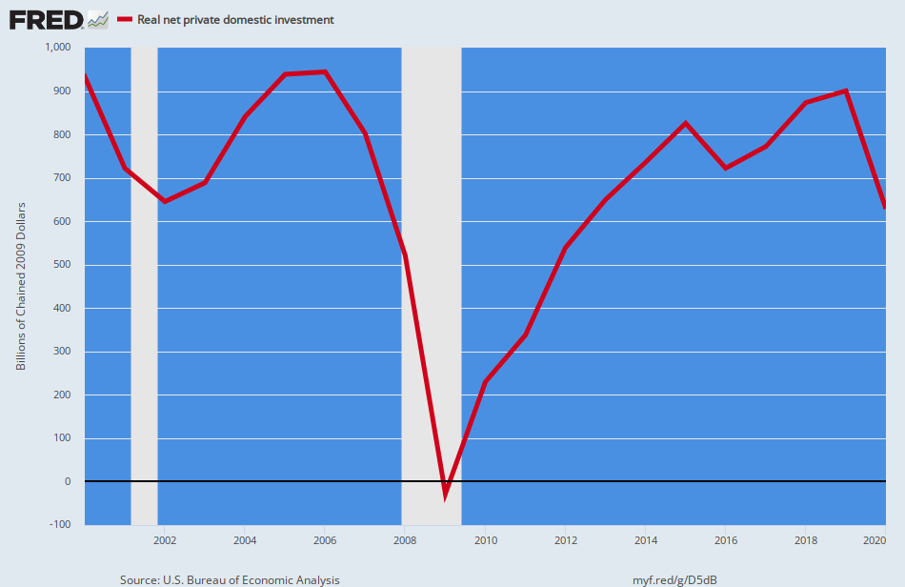
IT'S NOT STIMULATING DOMESTIC INVESTMENT, EITHER
Real Net Domestic Investment, 2000-2019.
Fed’s Balance Sheet Is Up by 18X From $500 Billion To $8.9 Trillion.
Real Net Investment In Productive Assets Flat since 2000.

Slide 19
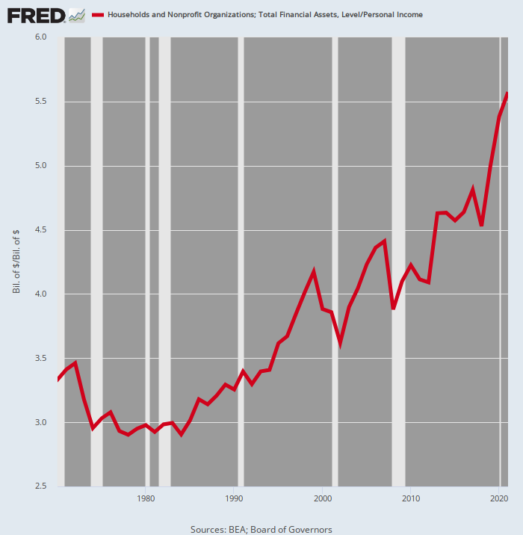
QUESTION: WHERE'd ALL THE STIMMIES GO BESIDES CHINA? ANSWER: FINANCIAL ASSET INFLATION!
Ratio Of Household Financial Assets To Personal Income, 1970-2021
This ratio is essentially the aggregate PE ratio for the entire US economy.
The 3.2X pre-Greenspan ratio has nearly doubled to 5.6X in 2021.
Yet the underlying growth rate of incomes has been systematically grinding lower to just half of the pre-2000 rate?
So red line is going in the wrong direction---it should be falling owing to far weaker economy.

Slide 20
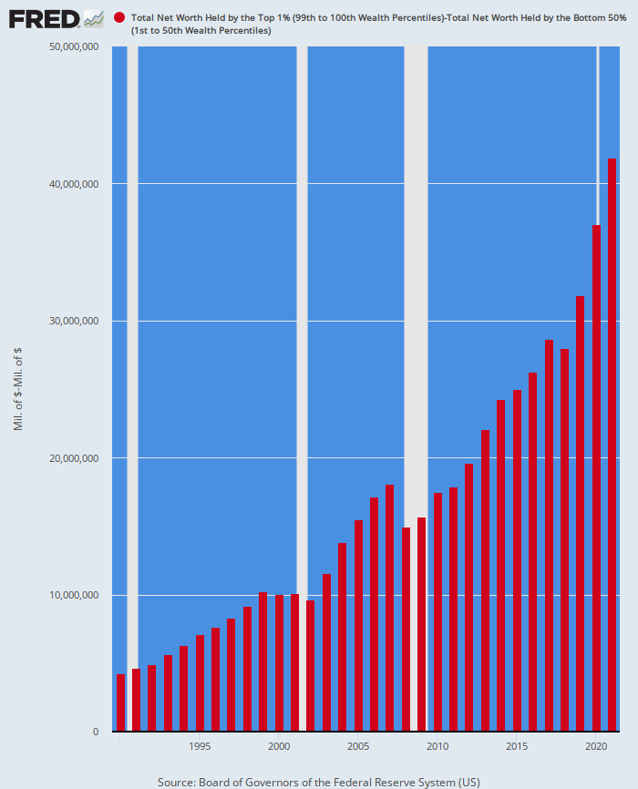
A DISPROPORTIONATE SHARE OF THE ASSET BUBBLE WENT TO THE TOP OF THE WEALTH LADDER---SO NOW COMES THE "REVERSE WEALTH EFFECT“
Net Worth of Top 1% Minus The Net Worth of the Bottom 50%
Ordinarily, the distribution of net worth isn't the business of the state, but the drastic imbalance shown below is precisely an artifact of state intervention by its central banking branch.
Net Worth, 1990 Versus 2021:
Bottom 50%: Net worth of $780 billion rose to $3.8 trillion= +$3.0 trillion.
Top 1%: Net worth of $5.0 trillion rose to $45.6 trillion = +$40.6 trillion.
The net worth of the top 1% exceeded that of the bottom 50% by about $4.3 trillion in 1990.
Today the gap is nearly $42 trillion.

Slide 21
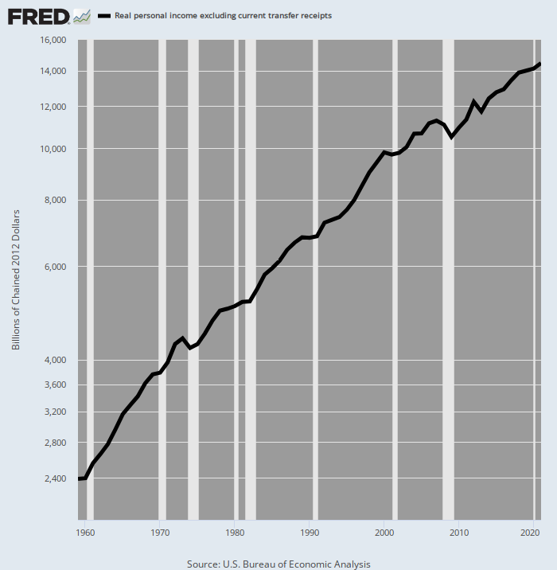
WHAT WEALTH EFFECT? REAL INCOME GROWTH LESS TRANSFER PAYMENTS UNDERWENT DRASTIC DECELERATION (Proxy for real private domestic growth)
Real Personal Income Less Transfer Payments, 1959-2021
Between 1959 and 2000 real personal income less transfer payments grew by 3.51% per annum.
Since then, the growth rate plunged to just 1.86% per annum.
That's just 53% of its pre-2000 level.

Slide 22
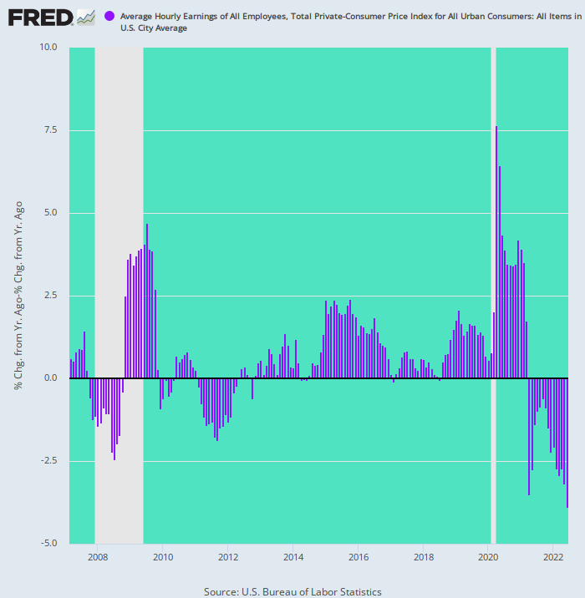
THE STIMMIES BACKFIRED BIG TIME---REAL WAGES ARE FALLING AT RECORD PACE
Y/Y Change In Inflation-Adjusted Hourly Wages, 2007-2022
Inflation-adjusted average hourly earnings are now down by 3.9% from prior year.
By far the largest Y/Y decline during the last 15 years.
Until unemployment rises considerably, workers will have inflation catch-up at the top of mind.
The June CPI report shows confirms all the ingredients for a price/wage/cost/price spiral.
No pivot to ease in the Eccles Building anytime soon.

Slide 23
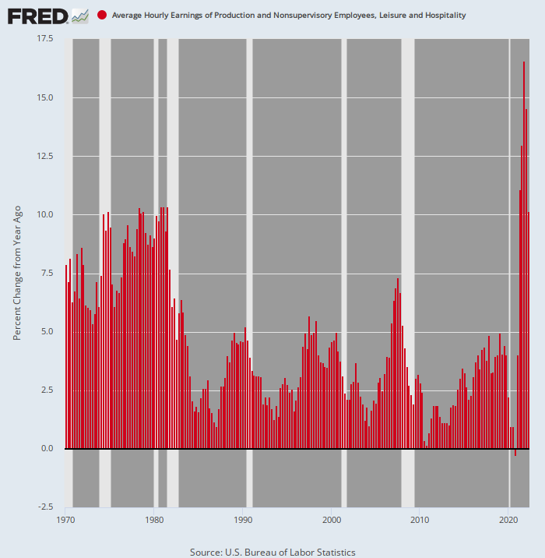
WHAT THE FED REALLY FEARS---A 1970S STYLE WAGE/PRICE SPIRAL
Even in the lowest wage precinct of the labor market, it's taking strong double-digit increases to even fill the dishwasher jobs and hotel cleaning maid jobs.
For the last five quarters running, the Y/Y increase for hourly earnings in the Leisure & Hospitality sector has ranged between 10% and 15%----far higher levels than occurred at anytime during the inflationary 1970s
Y/Y Change In Average Hourly Earnings, Leisure & Hospitality Sector, 1970-2022

Slide 24
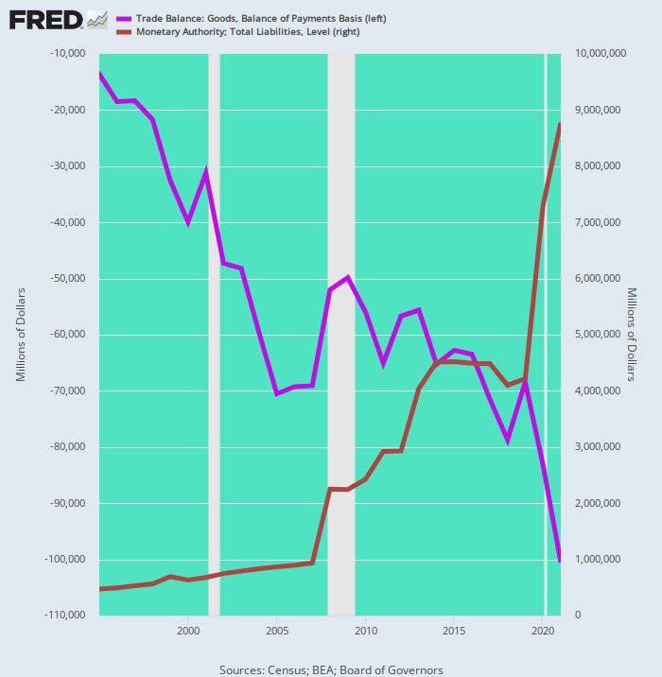
WHAT RAMPANT MONEY-PRINTING ACTUALLY FOSTERED AFTER 1995 WAS A MASSIVE OFFSHORING OF THE US INDUSTRIAL ECONOMY
Fed Balance Sheet Versus Monthly Deficit in Goods, 1995-2021
The Fed's balance sheet rose by 19X when it should have increased hardly at all owing to the need to purge the 1970s inflation.
So the implicit 2.00% inflation targeting policy caused a further 56% rise in domestic unit labor costs during the quarter-century period after 1995.
That inflated rather than deflated the dollar cost of production gap between the US and the China-based supply chains.
The monthly trade deficit in goods (purple line) rose from $13.6 billion in 1995 to $100.5 billion in 2021.

Slide 25
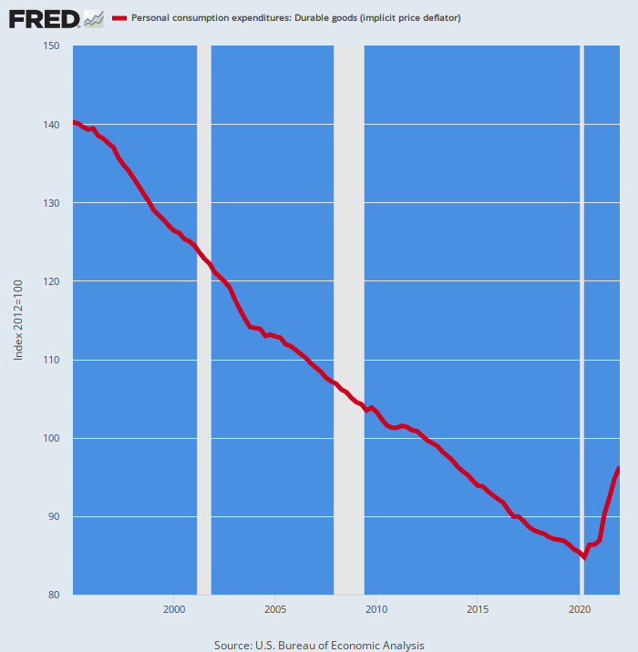
IN TURN, MASSIVE OFFSHORING FOSTERED THE DELUSION THAT THERE WERE NO INFLATIONARY CONSEQUENCES TO THE FED'S MADCAP MONEY-PRINTING
PCE Deflator For Durable Goods, 1995-2022
But "lowflation" was never a steady-state reality—just the one-time feedback effect of off-shoring and an artifact of the phasing of the global commodity cycle, plus a healthy pinch of hedonics.
If we are to believe the BLS (we don't), the PCE deflator for durable goods plunged by 39% between 1995 and 2019.
That’s a -2.0% annualized decline for one-quarter a century running!

Slide 26
GLOBALIZATION OF THE SUPPLY CHAIN CAUSED AS ONE-TIME DEFLATION OF DURABLE GOODS PRICES, AMPLIFIED BY HEDONICS
The proof is in the pudding when you look at the eras before Mr. Deng built his massive new export factories in China.
During the heyday of American non-inflationary prosperity between 1953 and 1968, the PCE deflator for durable goods rose by just 0.7% per annum.
But after the dollar was ripped from its anchor to gold at Camp David in August 1971, the durables deflator annual gain quadrupled through Q1 1995.
So there is nothing inherently deflationary about durable goods.
Instead, what happened between 1995 and 2019 was a giant labor and cost arbitrage which is now over and done.
The central banks should never have attributed that to "lowflation" and insufficient monetary stimulus, as they did for most of the past quarter century.

Slide 27
THE GLOBAL NONDURABLES CYCLE CREATED AN ARTIFICIAL FLAT-ZONE BETWEEN 2012 AND 2019
There was a huge wave of nondurables inflation between 1995 and 2008 (+50%) as the China supply chain rapidly cranked up its demands on global commodities.
But a low-interest rate driven surfeit of investment thereafter which brought prices back down to earth after 2012.
From 2012-2019, by contrast, the nondurables deflator remained flat as a board, temporarily pulling down the headline PCE deflator.
Now it has surged at a 4.23% rate through Q1 2022.

Slide 28
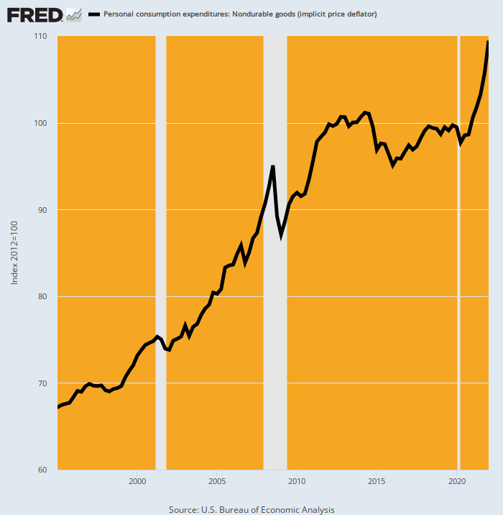
THE DECADE LONG CENTRAL BANKER JABBER ABOUT "LOWFLATION" WAS RANK NONSENSE
PCE Deflator For Non-Durable Goods, 1995-2022
Lowflation was just an artifact of the flat period of the cycle.
But nondurable goods prices have not been remotely lowflationary over the past 27 years, having risen by 63% or nearly 2% per annum during that span.

Slide 29
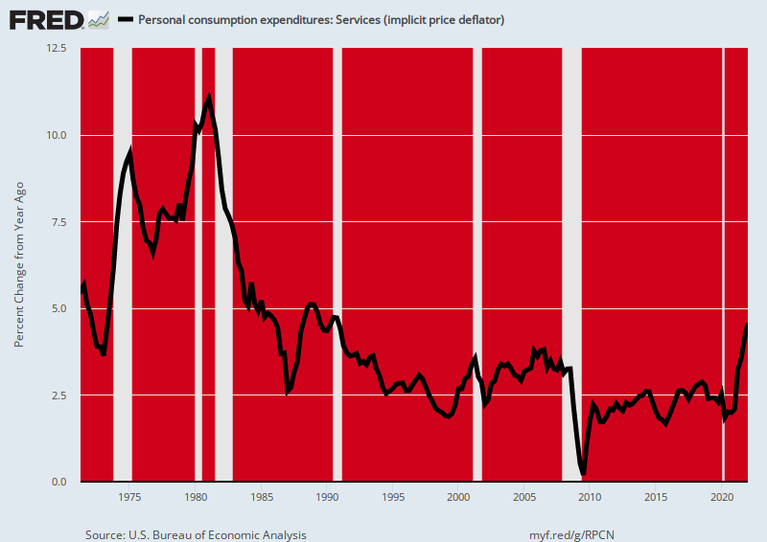
THE PCE DEFLATOR COMPONENT THE FED COULD MORE DIRECTLY INFLUENCE---SERVICES----WAS NEVER REMOTELY LOWFLATIONARY
Per Annum Increase, PCE Deflator For Services, 1971-2022:
1971-1995: 5.6%;
1995-2012: 2.7%;
2012-2019: 2.4%;
2019-2022: 3.2%

Slide 30
THE FED'S FEVERED MONEY-PUMPING TO PUSH UP INFLATION FROM BELOW DURING THE DECADE THROUGH 2019 WAS UNMITIGATED FOLLY
Per Annum Increase In PCE Deflator And Components, Q4 2011-Q4 2019:
PCE Durables: -2.01%;
PCE Nondurables: +0.11%;
PCE Services: +2.37%;
Overall PCE Deflator: 1.42%;

Slide 31
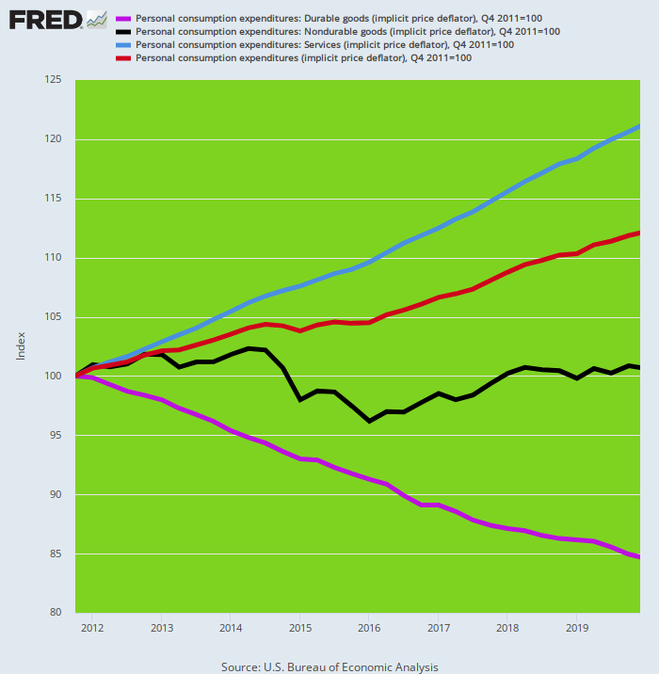
THE LOW HEADLINE PCE DEFLATOR WAS THEREFORE A STATISTICAL FLUKE
PCE Deflator And Its Components, Q4 2011-Q4 2019
Fully 36% of the weight in the Fed’s preferred PCE deflator was accounted for by globally traded durable and nondurable goods, where indices were flat/falling for reasons having nothing to do with "lowflation" or insufficient monetary expansion

Slide 32
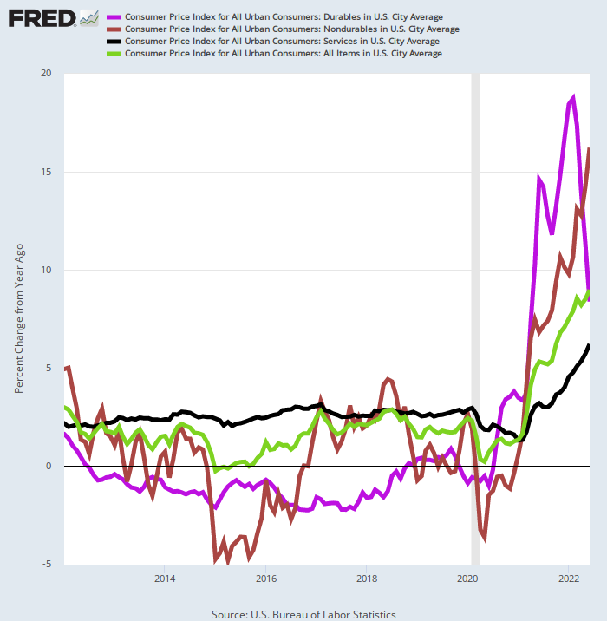
NOW THE INFLATIONARY CHICKENS ARE COMING HOME TO ROOST
Y/Y CPI Increase By Major Component, 2012-2022
2012-2019 CPI Inflation CAGR Versus June 2022 Y/Y Increase:
CPI Durables: -1.13% vs. +8.40%;
CPI Nondurables: +0.37% vs. +16.20%;
CPI Services: +3.00% vs. +6.20%;
Headline CPI: +1.83% vs. +9.10%

Slide 33
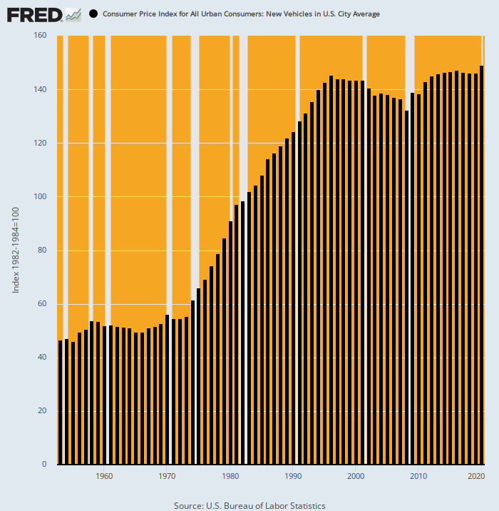
BUT THERE'S MORE.....HEDONICS!
CPI Index For New Autos, 1953-2020
Washington’s role in the above divergences is well illustrated by the CPI for new automobiles.
During the heyday of American prosperity over 1953-1971, new auto prices rose by just 1.0% per annum.
But after the Fed was cut loose from its anchor to gold in August 1971, car prices soared, rising by 165% through 1997--- a 6.3% per annum gain.
But according to the BLS, something unusual happened after the mid-1990s: Auto inflation purportedly disappeared entirely, with the CPI for new vehicles rising by just 0.15% per annum between 1997 and 2020.

Slide 34
EXCEPT, EXCEPT. THE DRAMATIC FLATTENING TREND SHOWN ABOVE DIDN'T ACTUALLY HAPPEN
If we take the sticker price of a mainstream vehicle like the Ford Mustang Coupe, it rose from $15,355 in 1997 to $39,800 in 2020.
That’s a 160% gain!
So the continuation of soaring prices in a major category of durable goods got transformed into “flat” by the hedonics mavens at the BLS.
Accordingly, the CPI auto index went up by just 3.5% during that 23-year period when sticker prices of typical autos like the Ford Mustang were rising by 46X more.

Slide 35
THIS GETS US TO THE FOLLY OF HEDONICS
The only thing workers have to purchase their vehicles with is their paychecks—whether that vehicle has improvements like airbags, better brakes, fancy electronics and advanced entertainment systems or not.
Therefore, we have computed the number of hours and months of work that the average employee had to put on the clock in order to buy that iconic Ford Mustang Coupe in 1971, 1997 and 2020.
And that data is dispositive—it took double the amount of work in 2020 as it did in 1971.
Mustang Sticker Price:
1971: $3,006;
1997: $15,355;
2020: $39,880;
Average Hourly Wage/Hours Worked To Purchase Vehicle:
1971: $3.60/hour, 835 hours;
1997: $12.50/hour, 1,228 hours;
2020: $24.97/hour, 1,597 hours;
Average Annual Worker Hours/Months To Purchase Vehicle:
1971: 1,908 hours per year/5.3 months;
1997: 1,800 hours per year/8.2 months;
2020: 1,778 hours per year/10.8 months;

Slide 36
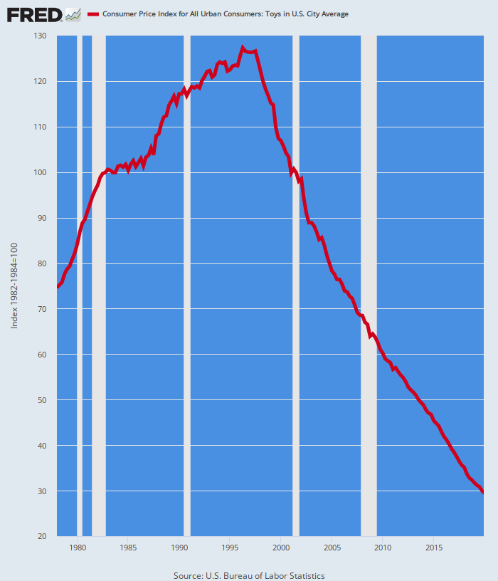
THERE'S MORE---WOULD YOU LIKE SOME JUNK TOYS WITH YOUR HEDONICS?
CPI Index for Toys, 1978-2019
Consistently applied hedonics might have actually required upward adjustment of nominal prices owing to the dramatic declines in quality and durability of Chinese products.
Yet the BLS says between Q4 1996 and Q4 2019 the index for toy prices plunged by 76%!
But that out-of-this-world -6.1 per annum drop doesn't remotely measures apples-to-apples.
When toys were still made in the US between 1978 and 1996, the CPI toys index rose by 69% or 3.0% per annum.
The crash thereafter was China labor arbitrage plus the substitution of plastic junk for the sturdier American-made toys of yesteryear.

Slide 37
HE FOLLY OF INFLATION TARGETING IN ONE COUNTRY
What we are getting at is that there is so much noise and arbitrariness in the CPI and PCE deflator that the very idea of targeting the general price level to a 2.00% gain per annum is just paint-by-the-numbers folly.
The government statistical agencies cannot measure inflation even remotely accurately, and in today’s global market-driven economy, the Fed’s flimsy interest rate tools can not impact it effectively and reliably anyway.
The idea of controlling goods and services inflation in one country is just plain nonsense---since inflation and deflation are transmitted globally.
Self-evidently, the Fed has little direct influence on the price for globally sourced energy and food, which account for 8.7% and 13.4% of the CPI, respectively.
But it clearly doesn’t stop there: The Fed can’t directly impact the inflation rate for OER, either, which accounts for another 24% of the CPI.
The latter's just finger in the air guesstimate of the Washington’s green eye-shades.

Slide 38
FINALLY, MIND THE "STICKY" VERSUS "FLEXIBLE" CPI---THEY ARE BOTH NOW SOARING
The “sticky price CPI” accounts for about 70% of the weight in the CPI index.
The “flexible price CPI” accounts for the other 30%.
So the Atlanta Fed calls a CPI component “sticky” if the price of items change less often, on average, than every 4.3 months. For example, on average---
OER price adjustments occur every 11.0 months.
Food away from home price adjustments occur every 10.7 months.
Public transportation costs, which soared more than 23% from a year ago in June, occur only every 9.4 months.
Medical services price adjustments happen every 14 months.

Slide 39
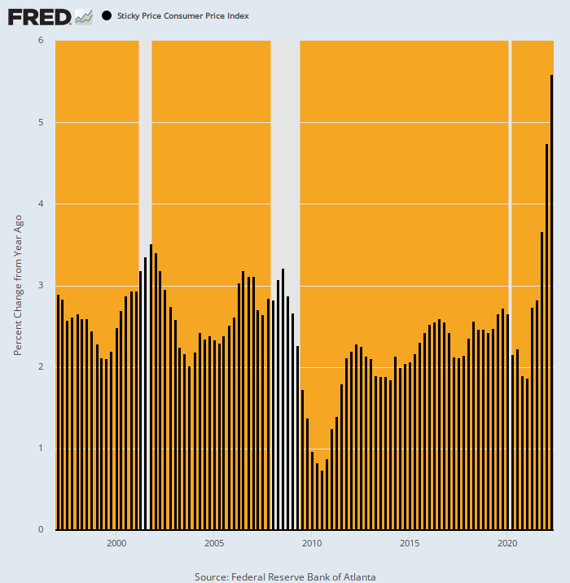
IN JUNE, THE STICKY PRICE INDEX HIT A 31-YEAR HIGH, RISING AT 5.6% Y/Y
Y/Y Change In Sticky Price CPI
That’s nearly double the Y/Y rate that has prevailed since 1997
This breakout suggests that inflation is already far more embedded than the Fed would like to admit, and has considerable momentum going forward.

Slide 40
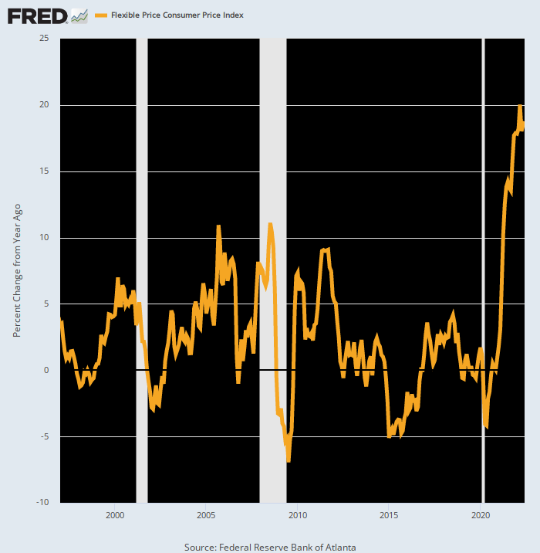
THE FLEXIBLE PRICE INDEX WAS UP 18.7% IN JUNE
Y/Y Change In Flexible Price CPI, 1970-2022
The flexible price CPI has displayed a wholly different pattern since the Fed embraced inflation targeting the late 1990s.
For the next 23 years, the flexible price index was essentially a wash, reflecting the ups and downs of the global commodity cycle.
But owing to the Ukraine War and supply chain disruptions the flexible price index is now at a 52-year high.
So 30% of the CPI may come off the boil in the quarters ahead, but the price level will remain far higher than before.
So what is it that the Fed is attacking with its inflation targets?
It has no clue!

Slide 41
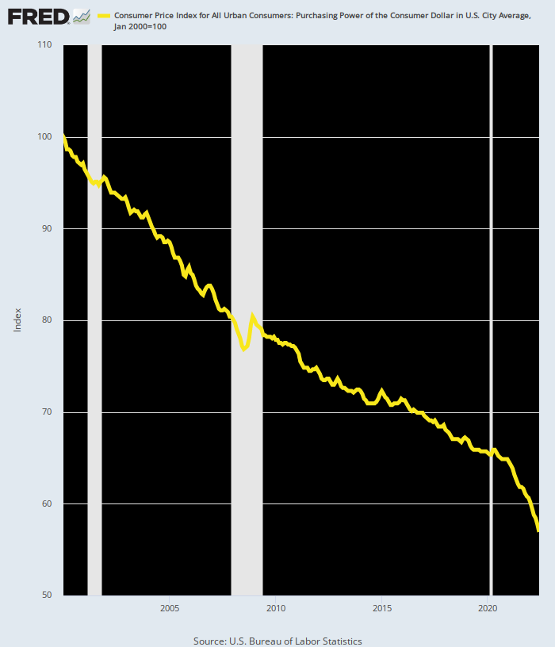
ALL ALONG THE FED'S REAL FOCUS WAS ON ITS MISBEGOTTEN 2.00% INFLATION TARGET
Purchasing Power of The Consumer Dollar Since January 2000
And in one sense it did succeed in that endeavor: Since money-pumping commenced in earnest after the dotcom crash, the purchasing power of the consumer’s dollar has shrunk by 43%!
So the Fed now has double-digit inflation on its hands.
Has no choice except to tank both Wall Street and main street as it desperately attempts to cope with its money-printing folly of decades.

